Slide 1



Developing Healthy Networking Skills
Domark Health and Education Foundation
www.dohef.org/learn
info@dohef.org
facebook.com/dohef

Slide 2

1. Understand what network and networking is
2. How to identify important networking skills
3. How to develop networks
4. How to maintain your network

Slide 3
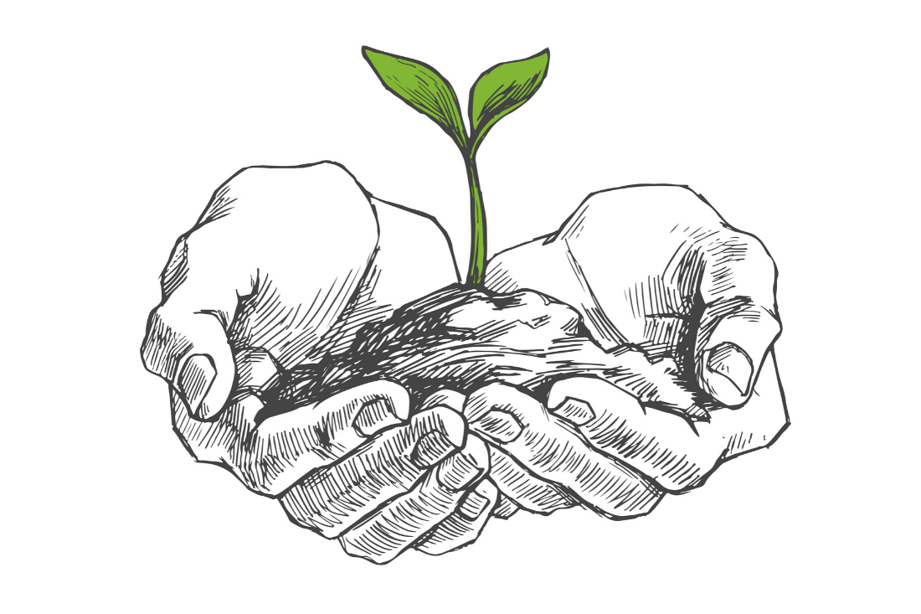
To be the best at what you do, you need to surround yourself with people who inspire you, who motivate you, and who challenge you. People who ask you difficult questions and provide honest feedback. Networking is the practice of intentionally seeking out these people.

Slide 4

Networking skills
Be open to meeting new people
Listening to new ideas, and engaging with people outside of your specific business or industry.
Be authentic in how you present yourself and your business.
Networking requires a genuine interest in others. They deserve your respect and your attention.

Slide 5

Networking skills
Be a good listener for common goals and interests and establish useful relationships.
Be punctual and respect how much time your contacts are able to give you.
Be proactive and conduct research on the individual, the employer or the industry with whom you would like to connect.

Slide 6

Ways to develop your network
Reach out to friends, family members and alumni — they are a rich pool of people with connections.
Seek to connect with people informally at conferences and meetings or at formal events.
Begin your conversation with what you know about the person or the organization, talk about your common interests, and build your conversation from there.
Offer to help - Let them know how you possibly can help them.

Slide 7
Ways to develop your network
Make connections through social media such as LinkedIn. LinkedIn can connect you to others with similar interests, it can help you establish wider networks, and is a rich resource of information for professional development.
When you communicate with people through face-to-face interviews, over the phone or some other system, be prepared with questions. Use the Internet, if you have access.
Ask for contact information and a business card if possible.
Reciprocate — be a resource for those in your network.

Slide 8

Your network is built over time because all connections you make become part of your personal and professional network. Think about it as something that is alive and that requires time and your attention to stay healthy and relevant.

Slide 9
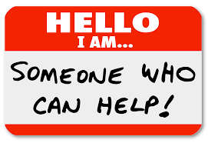
How to Maintain Your Network
Reach out to your contacts when something reminds you of them. Let them know you are thinking about their needs and not just what they can do for you. This will help you build a strong foundation for a continued relationship.
Share along occasional updates or interesting relevant information about yourself.
Reach out to your contact in advance of coordinated job searches. Send your resume and the job description to the position that you are applying. Keep your contact informed about the outcome and write them a thank-you note if they in any way help.

Slide 10

How to Maintain Your Network
Remember what you talked about with your contacts when you met them. A good way to remember is to write quick notes on their business card.
Be sure to follow up with a new contact within 24 to 48 hours.
If your contact connects you to a valuable resource, please let that person know what happened as a result of this connection.
Be thankfull

Slide 11

Networking can be a powerful tool
Domark Health and Education Foundation

